Slide 1
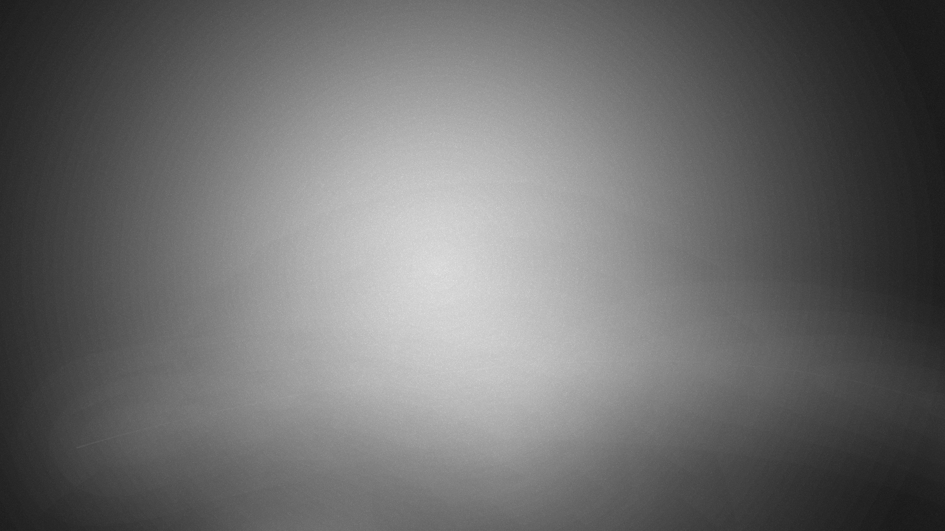

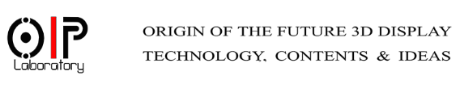
Faster hologram generation by max-depth-range method
MD SIFATUL ISLAM
ID: 2017234017
Masters student, OIP lab, Chungbuk National University
Email : sifatul@CBNU.ac.kr

Slide 2



Table of contents
Motivation
(Multiple) Wavefront Recoding Plane method
Proposed max-depth-range (MDR) method
Results and Summary

Slide 3

Motivation
Point cloud of real scenes with multiple objects => discreet distance between WRP and the farthest depth layer in a depth-range
Long computational time
Non- uniformity in color

Slide 4
Wavefront recording plane (WRP) method
WRP calculates CGH in the following steps:
3D Information from each object point is calculated onto the WRP, using equation 1.
Light wave from WRP is diffracted to CGH based on Fresnel diffraction[1]
Point cloud
Equation. 1
R_{j}
Diffraction
WRP
Active Area
Equation. 2
CGH
Fig 1. Schematic diagram of single WRP method
1. Tomoyoshi Shimobaba, Nobuyuki Masuda, and Tomoyoshi Ito, "Simple and fast calculation algorithm for computer-generated hologram with wavefront recording plane," Opt. Lett. 34, 3133-3135 (2009)
Notes:
1. Tomoyoshi Shimobaba, Nobuyuki Masuda, and Tomoyoshi Ito, "Simple and fast calculation algorithm for computer-generated hologram with wavefront recording plane," Opt. Lett. 34, 3133-3135 (2009)

Slide 5
Conventional Multiple Wavefront recording plane (M-WRP) method
No. of WRP = 2
No. of WRP = 4
In Conventional M-WRP method :
Point cloud is divided into series of depth layers
WRP is placed at fixed intervals
Depth-range 1
(4 depth layers)
WRP 1
Depth-range 1
( 8 depth layers)
WRP 1
Depth-range 2
(4 depth layers)
WRP 2
Depth-range 3
(4 depth layers)
WRP 3
Depth-range 2
( 8 depth layers)
WRP 2
θ
Depth-range 4
(4 depth layers)
WRP 4
Diffraction
Diffraction
CGH
CGH
Fig 2. Schematic diagram of Conventional Multiple WRP (M-WRP) method

Slide 6
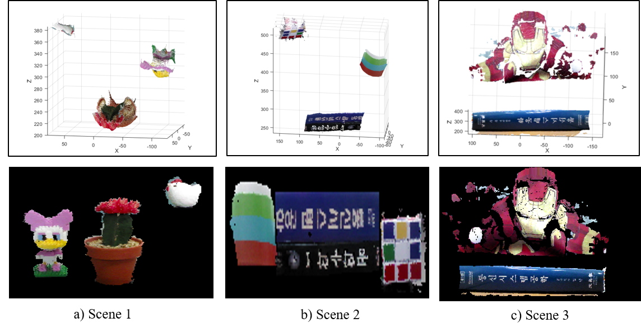
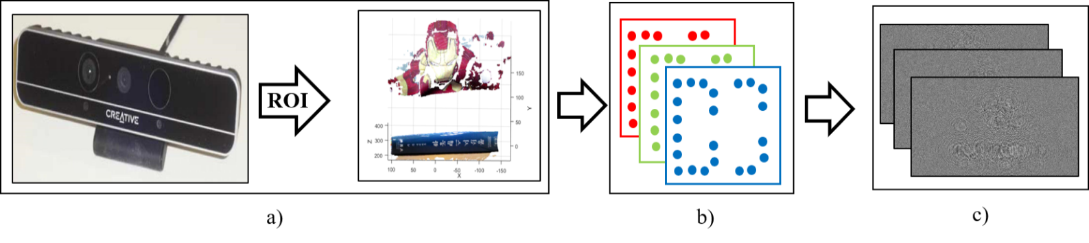
Max-depth-range (MDR) method
Proposed MDR method can be simplified into three steps:
Real scene is captured with depth camera and point cloud is created
Depth grid is created based on red, green, blue color channel
Depth ranges are created, WRPs are placed and holograms are created
Fig 3. Point cloud of different scenes and their respective two dimensional (2-D) images
Fig 4. Block diagram of hologram generation in MDR method

Slide 7
Max-depth-range (MDR) method
Depth range is created by:
L is calculated based on equation 3
2×L distance create the temporary depth-range [Fig. 5(i)]
WRP is placed in the center of all depth layers within temporary depth-range
Equation. 3
L
Temporary depth-range 1
WRP 1
Depth-range 1
WRP 1
Depth-range 1
L
L
Temporary depth-range 2
L
Diffraction
CGH
Diffraction
CGH
Diffraction
CGH
(i)
(ii)
(iii)
Fig 5. Block diagram of hologram generation in MDR method

Slide 8
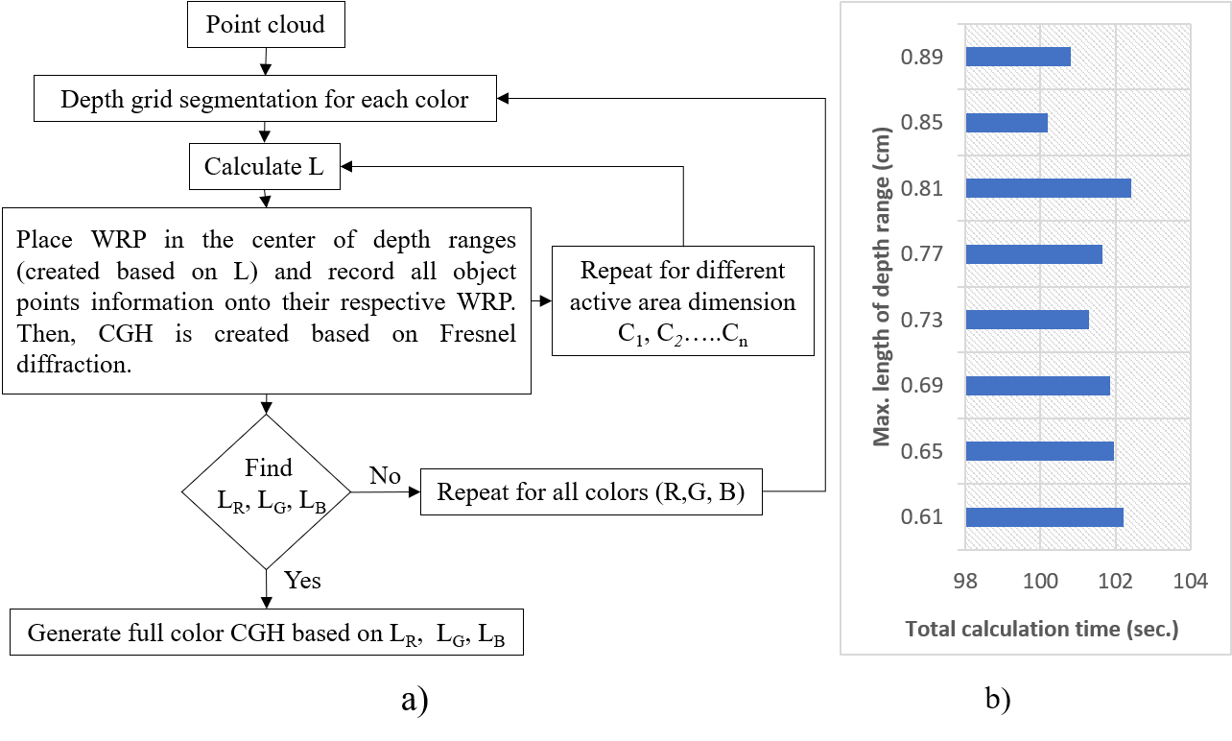
Max-depth-range (MDR) method
Fig. 6. a) Flowchart of proposed method, and b) CGH generation time for different values of L.

Slide 9
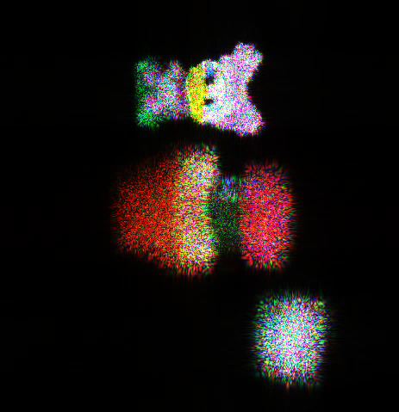
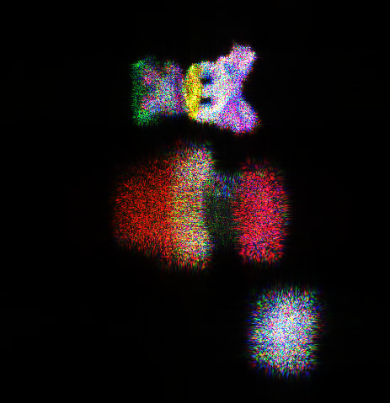
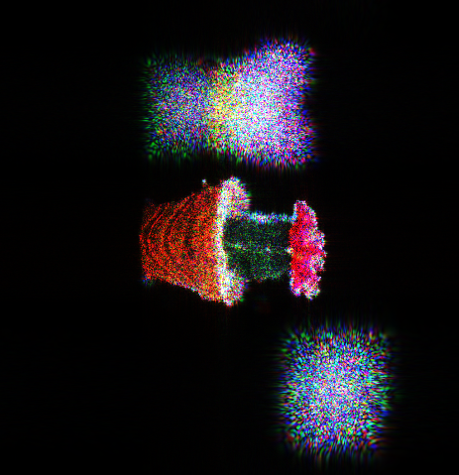
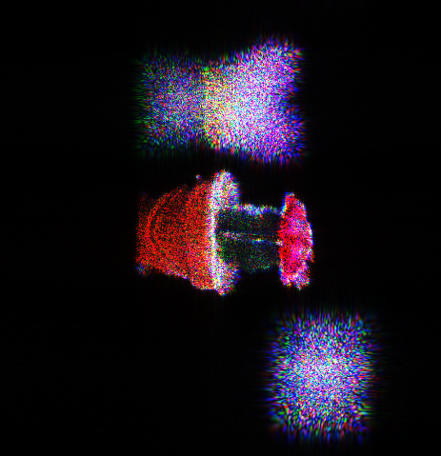
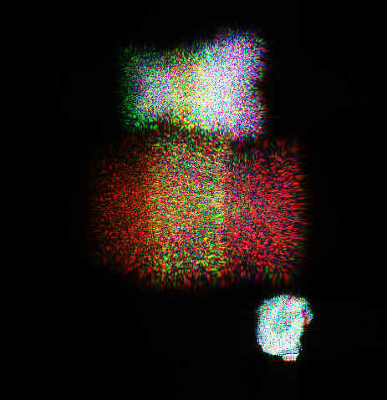
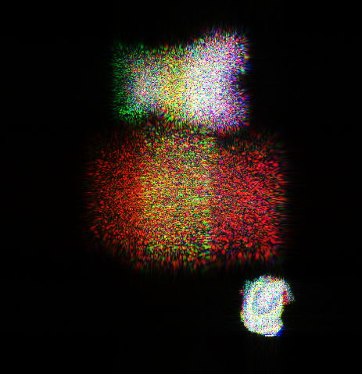
Numerical simulation
Resolution | Scene 1 |  | Calculation time (sec.)
512 × 512 | Conventional M-WRP Method | 2 WRPs ∕color × 3 colors 4 WRPs ∕color × 3 colors 8 WRPs ∕color × 3 colors 16 WRPs ∕color × 3 colors 32 WRPs ∕color × 3 colors 64 WRPs ∕color × 3 colors | 53.174 44.286 39.695 37.711 38.881 38.727
 | Proposed MDR method | 16 WRPs (red) + 12 WRPs (green) + 14 WRPs (blue) | 26.477
720 × 720 | Conventional M-WRP Method | 2 WRPs ∕color × 3 colors 4 WRPs ∕color × 3 colors 8 WRPs ∕color × 3 colors 16 WRPs ∕color × 3 colors 32 WRPs ∕color × 3 colors 64 WRPs ∕color × 3 colors | 96.789 84.652 80.433 80.732 82.979 85.769
 | Proposed MDR method | 10 WRPs (red) + 7 WRPs (green) + 6 WRPs (blue) | 52.918
1024 × 1024 | Conventional M-WRP Method | 2 WRPs ∕color × 3 colors 4 WRPs ∕color × 3 colors 8 WRPs ∕color × 3 colors 16 WRPs ∕color × 3 colors 32 WRPs ∕color × 3 colors 64 WRPs ∕color × 3 colors | 150.774 147.078 144.846 143.450 147.368 156.447
 | Proposed MDR method | 11 WRPs (red) + 10 WRPs (green) + 10 WRPs (blue) | 94.976
PSNR = 14.90 dB
PSNR = 15.37 dB
PSNR = 17.40 dB
PSNR = 17.25 dB
PSNR = 14.06 dB
PSNR = 14.31 dB
a) M-WRP method
b) MDR method
Fig. 7. Scene 1 reconstructed at 1,024 × 1,024 resolution, using the conventional M-WRP (top) and the proposed MDR method (bottom): focused on the a) toy, b) cactus, and c) hen.
Table 1. Calculation times of the conventional M-WRP and MDR methods for Scene 1 at different resolutions.

Slide 10
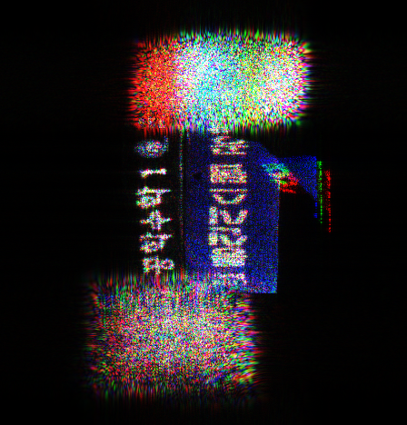
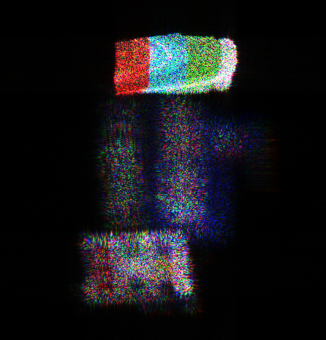
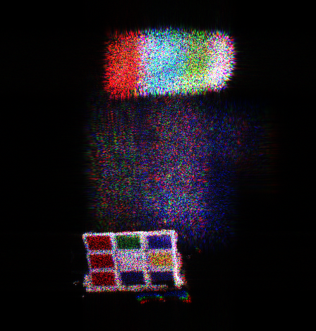
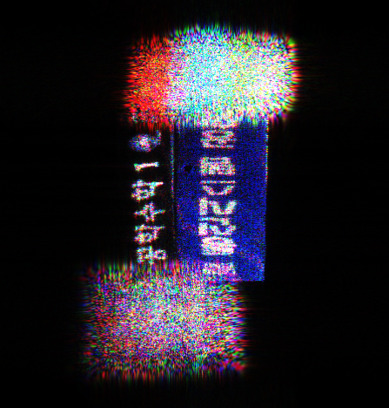
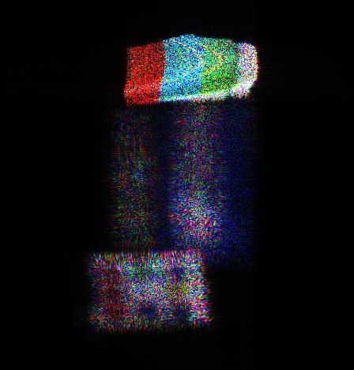
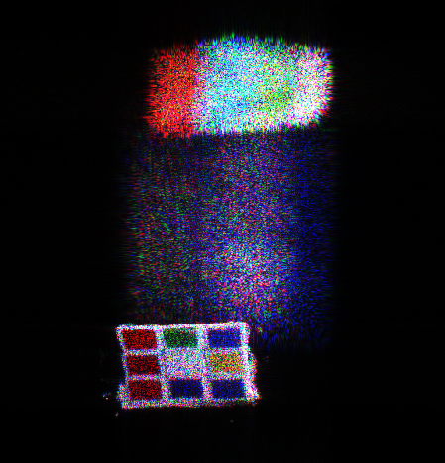
Numerical simulation
PSNR = 17.59 dB
PSNR = 12.92 dB
PSNR = 14.55 dB
PSNR = 16.44 dB
PSNR = 13.03 dB
PSNR = 14.19 dB
a)
b)
c)
Fig. 9. Scene 2 reconstructed at 1,024 × 1,024 resolution, using the conventional M-WRP (top) and the proposed MDR method (bottom), focused on the a) book, b) cup, c) cube.
Fig. 8. Calculation times for different resolutions using the conventional M-WRP and MDR methods.

Slide 11
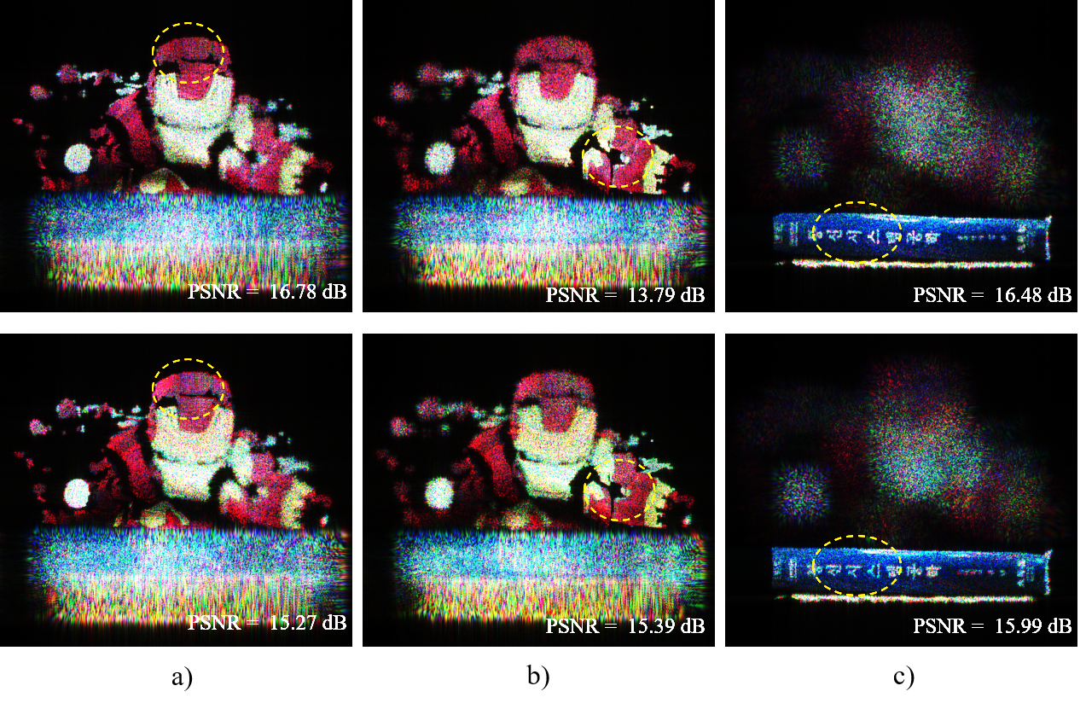
Numerical simulation
Scene 3 (1024×1024) |  | Calculation time (sec.)
Conventional M-WRP Method | 2 WRPs ∕color × 3 colors 4 WRPs ∕color × 3 colors 5 WRPs ∕color × 3 colors 8 WRPs ∕color × 3 colors 10 WRPs ∕color × 3 colors 16 WRPs ∕color × 3 colors 20 WRPs ∕color × 3 colors 40 WRPs ∕color × 3 colors | 254.338 260.845 241.236 298.614 255.353 250.442 254.023 257.459
Proposed method | 7 WRPs (red) + 5 WRPs (green) + 5 WRPs (blue) | 197.596
Table 2. Calculation times of the conventional M-WRP method and MDR method for Scene 3 at 1,024 × 1,024 resolution.
Fig. 10. Scene 3 reconstructed at 1,024 × 1,024 resolution, using the conventional M-WRP (top) and proposed MDR methods (bottom) focused on the a) head, b) shoulder, c) and book.

Slide 12
Numerical simulation
Fig. 11. Point cloud (top) and 2-D image (bottom) of Scene 4
Fig. 12. Scene 4 reconstructed at 1,024 × 1,024 resolution, using the conventional M-WRP (top) and proposed MDR methods (bottom) focused on the a) cup, b) cube, c) hen, d) and book.

Slide 13
Numerical simulations
Resolution | Point cloud (No. of object point) | No. of depth layer | Conventional M-WRP |  | MDR method |  | Computational enhancement (%)
 |  |  | No. of WRPs | Time (sec.) | No. of WRPs | Time (sec.)
1,024 × 1,024 | Scene 1 (35,263) | 128 | 48 | 143.45 | 31 | 94.98 | 33.79
 | Scene 2 (84,549) | 96 | 12 | 159.63 | 16 | 135.56 | 15.08
 | Scene 3 (91,307) | 80 | 15 | 241.24 | 17 | 197.60 | 18.09
 | Scene 4 (96,105) | 100 | 6 | 244.05 | 9 | 215.90 | 11.54
720 × 720 | Scene 1 (35,263) | 128 | 24 | 80.43 | 23 | 52.92 | 34.21
 | Scene 2 (84,549) | 96 | 12 | 86.76 | 17 | 70.76 | 18.44
 | Scene 3 (91,307) | 80 | 120 | 168.10 | 21 | 127.71 | 24.02
 | Scene 4 (96,105) | 100 | 6 | 102.10 | 13 | 87.09 | 14.70
512 × 512 | Scene 1 (35,263) | 128 | 48 | 37.71 | 42 | 26.48 | 29.79
 | Scene 2 (84,549) | 96 | 96 | 36.29 | 44 | 31.30 | 13.76
 | Scene 3 (91,307) | 80 | 120 | 58.45 | 34 | 49.28 | 15.69
 | Scene 4 (96,105) | 100 | 6 | 49.36 | 10 | 37.48 | 24.06
Table 3. Summary of numerical simulations using conventional M-WRP and proposed MDR methods.

Slide 14
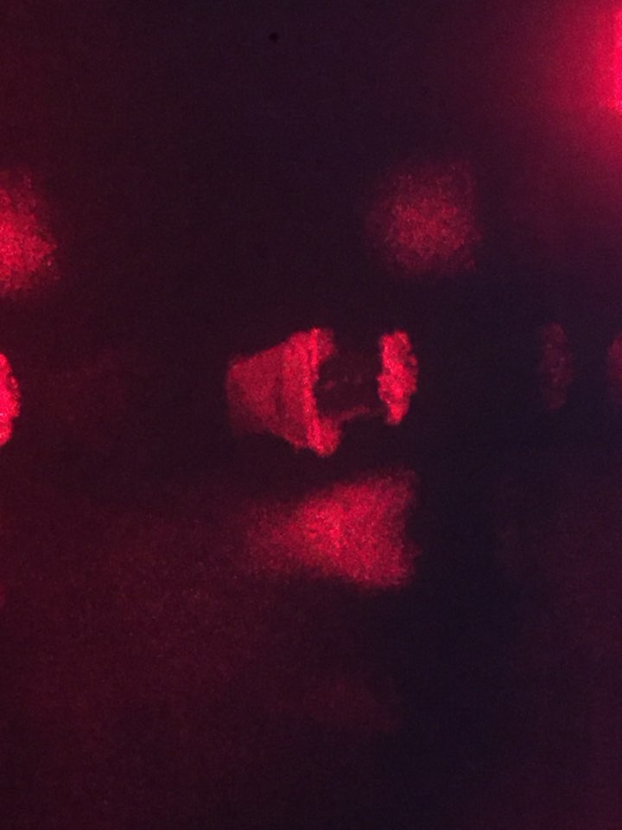
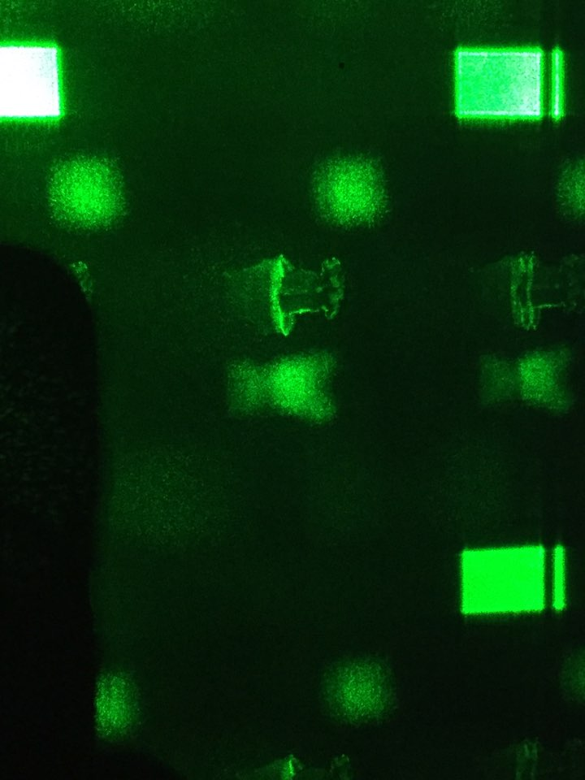
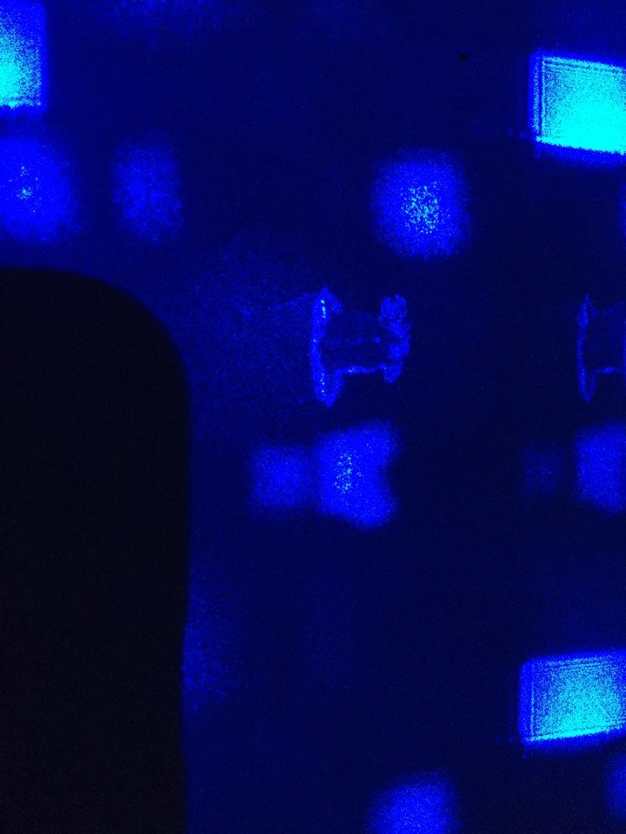
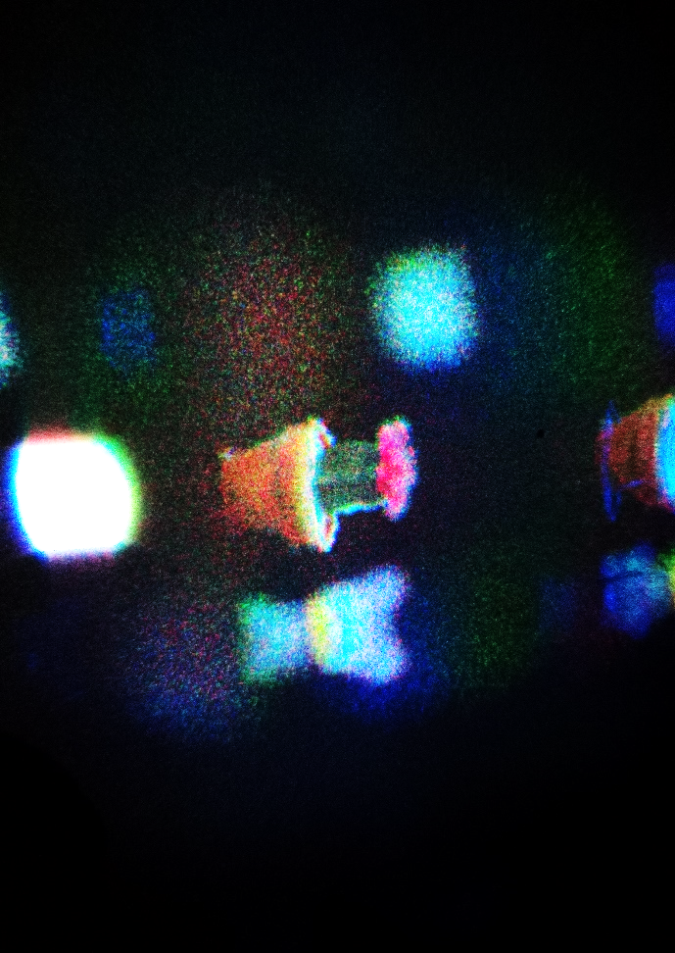
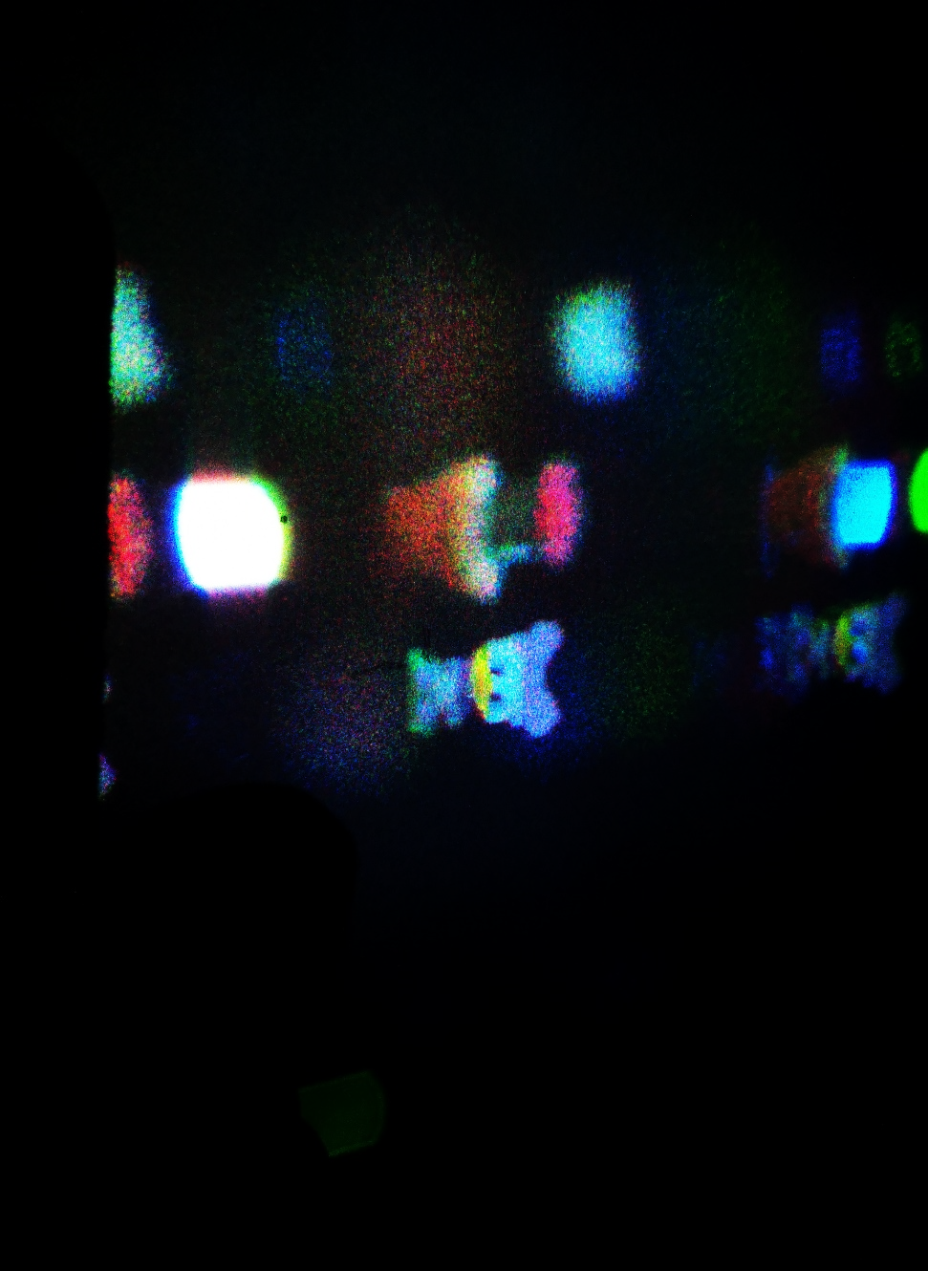
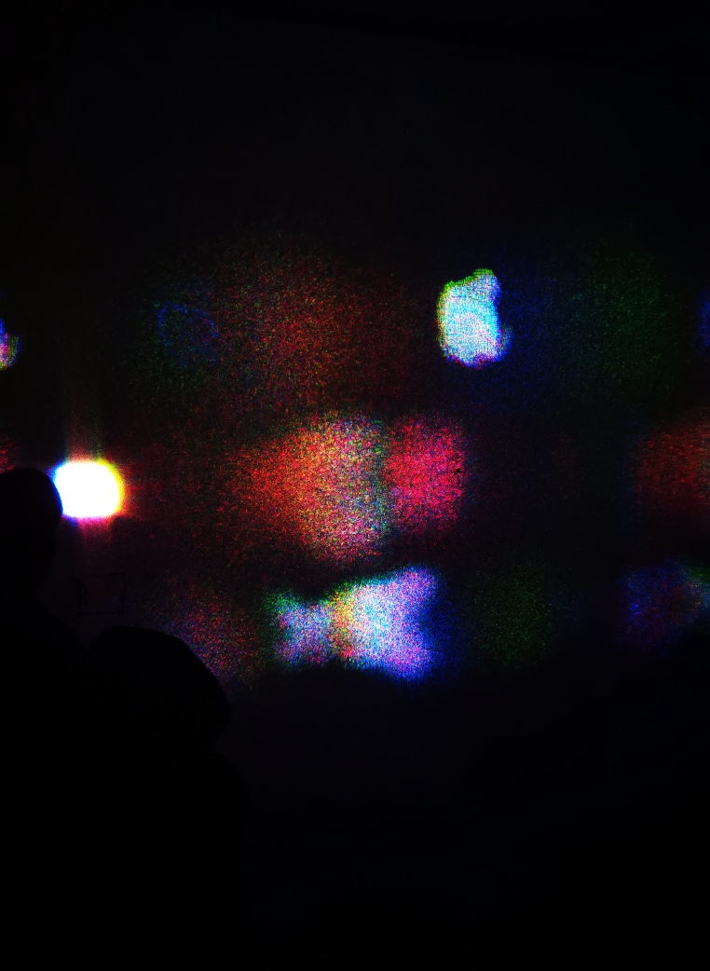
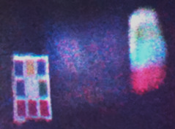
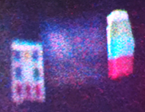
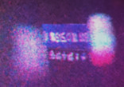
Optical experiments
Fig. 11. Monochromatic a) red, b) green, c) and blue images of Scene 1, full-color reconstructed images of Scene 1 focused on the d) cactus, e) toy, f) and hen. Full-color reconstructed images of Scene 2 focused on the g) cube, h) cup, i) book, at 1,024 × 1,024 resolution, using the proposed MDR method.
a)
b)
c)
d)
e)
f)
g)
h)
i)

Slide 15
Conclusion
15
No. of WRP is optimized by restricting the distance between the farthest depth layers and the WRP.
Faster full-colour hologram is proven by numerical simulation of real objects, and optical experiments.
Compared with conventional M-WRP method, proposed MDR method is capable of around 12~34% faster hologram generation.

Slide 16
Thank you!

